Slide 1


CSE332
Industrial Ethics and Legal Issues
Ethical Behavior of IT Professional

Slide 2
ETH ICS IN INFORMATION TECHNOLOGY
Here are some examples that raise public concern about the ethical use of information technology:
Ethical concerns in technology's workplace use.
Copyright violation harms music and films.
Spam emails enable low-cost marketing.
Hacking, plagiarism, and tracking persist. ​

Slide 3

Profession
A profession is a calling that requires specialized knowledge and often long and intensive academic preparation.
Professional ?

Slide 4
Professional Employee
One who is engaged in the performance of work .
Specialized intellectual instruction.
Exercise of discretion and judgement.

Slide 5


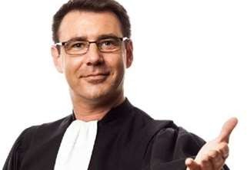
Professionals such as doctors, lawyers, and accountants require advanced training and experience; they must exercise Carefulness and judgment in the course of their work.

Slide 6
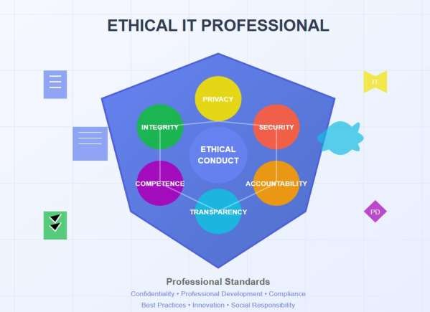

Are IT Workers Professionals?
Specialized Knowledge
Ethical Behaviour
Accountability
Commitment to Continuous Learning

Slide 7
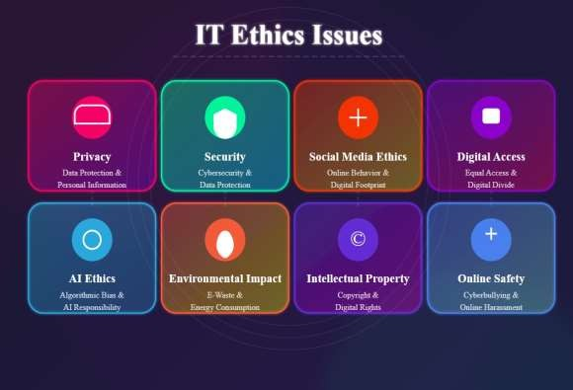
Common Ethical Issues For IT Users
Privacy Concern
Cybersecurity Risks
Misuse of IT Resource
Surveillance and Monitoring

Slide 8
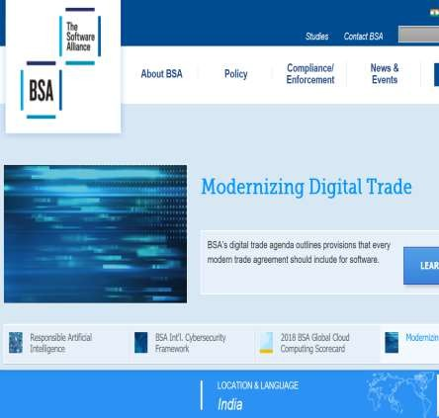
Business Software Alliance (BSA)
The Business Software Alliance
(BSA) is
represents
software
a trade group that the world’s largest and hardware
manufacturers.
Its mission
is to stop the copying of its
unauthorized
software
members.
produced by

Slide 9
More than 100 BSA lawyers and investigators prosecute thousands of cases of software piracy each year.
BSA investigations are usually triggered by calls to the BSA hotline, reports sent to the BSA Web site (www.nopiracy.org), and referrals from member companies.

Slide 10
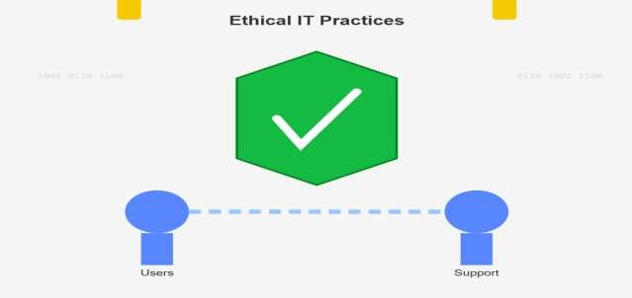
Supporting the Ethical Practices Of IT
Users
Education And Awareness
Clear Policies and Standards
Access Control and Security
Ethical Use Of AI And Automation
Collaboration and community Involvement

Slide 11
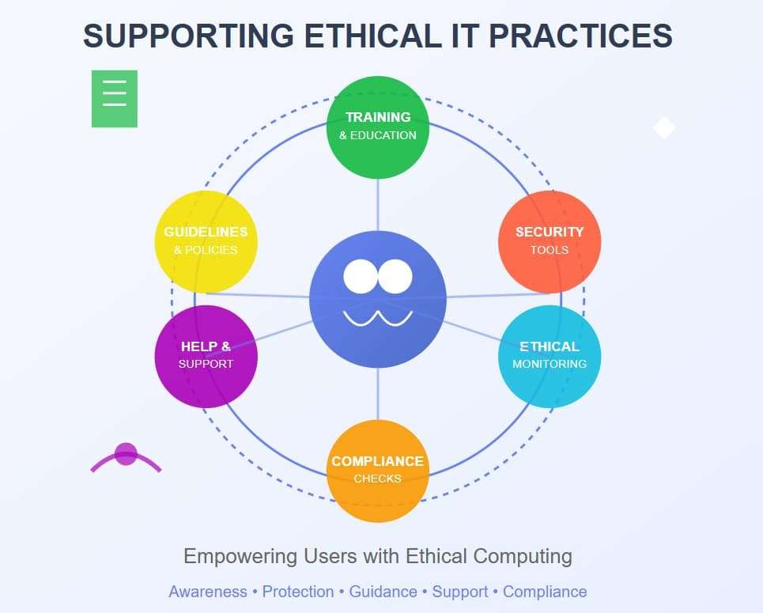
Supporting the Ethical Practices

Slide 12
Women Empowerment
Promoting gender equality in STEM fields.
Education and mentorship
Bias training
Support networks

Slide 13
2. Initiatives for women leadership in engineering.
The Society of Women Engineers (SWE)
Corporate programs

Slide 14
3. Programs encouraging girls in technology.
Girls Who Code-works to close gender gap in technology and computer science. It was founded in 2012 by Reshma Saujani.
STEMettes- its goal is to increase number of women in STEM fields. It was founded in 2013 by Anne-marie Imafidan.( organize, coding session, Hackathon, workshops)
4. Examples of empowered women in engineering.

Slide 15
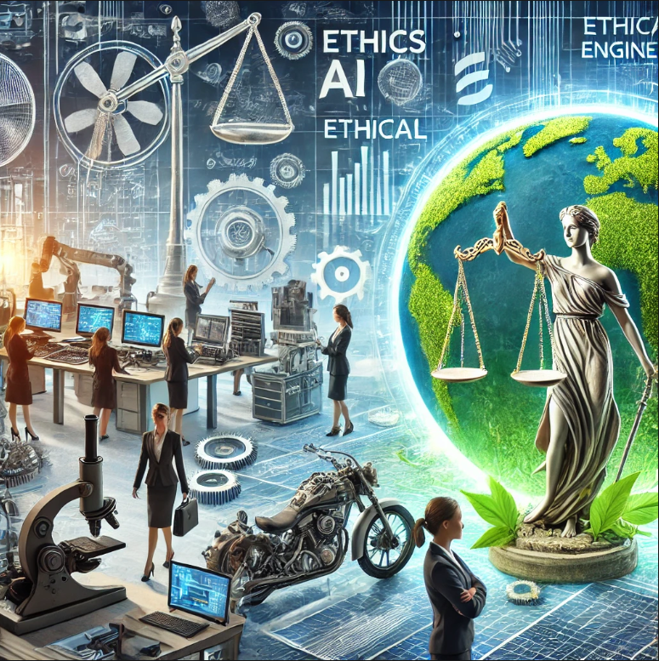

Women Empowerment

Slide 16
Ethical Aspects of Engineering Practices
Integrity and accountability in engineering.
being honest, transparent, and fair in all aspects of work,
from designing to testing to reporting results
engineers are held responsible for their designs, decisions, and their outcomes.

Slide 17
2. Environmental sustainability in engineering projects.
Green engineering
using renewable energy sources,
reducing waste,
and recycling materials.

Slide 18
3. Ensuring safety and reliability.
Engineers use quality control, and safety standards
ensure the safety of their designs.
to ensuring that a product or system performs consistently over time without failure.

Slide 19
4. Recent ethical challenges in AI and automation
Bias and fairness in AI algorithms
Job displacement due to automation
Accountability for autonomous systems

Slide 20
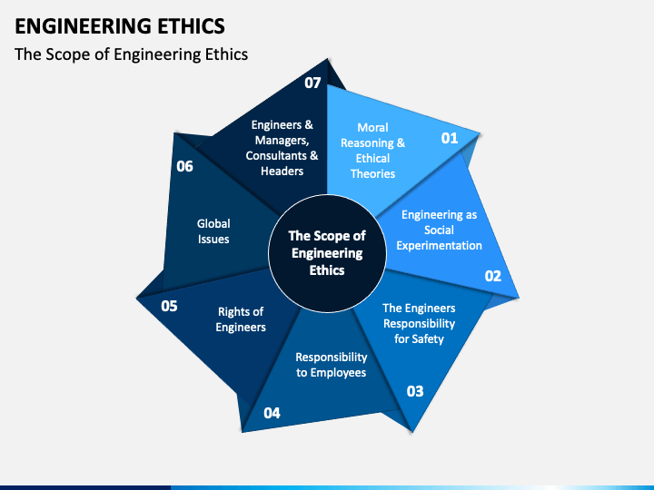

Slide 21
Recent Trends in Women Empowerment and Ethics
1. Rise of women-led startups in technology.
2. Increased focus on diversity in hiring policies.
3. Ethical AI design and its societal impact.
4. Inclusion of ethics in engineering curriculum.

Slide 22
MCQ
1. An organization enforces strict compliance policies but employees still engage in unethical behavior due to peer pressure. This situation highlights the limitation of:
A. Corporate governance B. Ethical decision-making models C. Compliance-based ethics programs D. Integrity-based ethics programs
2.
Which of the following best distinguishes integrity from ethics in a professional context? A. Integrity is externally enforced, while ethics is internal B. Ethics refers to laws, integrity refers to emotions C. Integrity is adherence to moral principles even without supervision D. Ethics applies only to organizations, integrity to individuals

Slide 23
3.A software engineer knowingly ignores a minor security flaw to meet a deadline. Which ethical principle is MOST directly violated? A. Transparency B. Non-maleficence C. Accountability D. Professional competence
4.In ethical decision-making, the “moral intensity” of an issue is LEAST influenced by: A. Magnitude of consequences B. Social consensus C. Probability of effect D. Organizational hierarchy

Slide 24
5.Which concept emphasizes creating systems where employees are encouraged to act ethically through shared values rather than strict rules? A. Regulatory ethics B. Compliance-based ethics C. Integrity-based ethics D. Utilitarian ethics
6.In IT professional ethics, “due diligence” primarily refers to: A. Completing tasks quickly B. Ensuring thoroughness and responsibility in actions C. Following only legal requirements D. Delegating tasks efficiently

Slide 25
7.Which of the following BEST illustrates ethical behavior in information technology? A. Using open-source code without attribution B. Sharing passwords for convenience C. Reporting system vulnerabilities responsibly D. Ignoring outdated security protocols
8.Women empowerment in ethical IT practices primarily aims to: A. Increase workforce size B. Ensure equal opportunities and reduce bias C. Improve company profits D. Reduce training costs

Slide 26
9.A company collects user data without explicit consent but uses it to improve services. This raises concerns primarily related to: A. Intellectual property B. Ethical transparency and consent C. Business profitability D. Technical feasibility
10.A developer refuses to implement a feature that invades user privacy, despite management pressure. This action is an example of: A. Ethical egoism B. Professional integrity C. Legal compliance D. Cultural relativism

